Slide 1
Statistical and Predictive Modeling Assignment 4- Chi-Squared Analysis
Name of the Student: Maisha Khatoon
Student ID: 100899259

Slide 2
Description of the Analysis
This study compares passenger capacity and vehicle airbag types using the Chi-squared test.
The dataset has two category variables: passengers and airbags.
The Chi-squared test determines if these variables are related.
It uses a contingency table to compare observed and anticipated rates under independence.
This investigation examines whether passenger capacity affects car airbag types.
By examining this link, the analysis aims to learn about car airbag designs and passenger safety.

Slide 3
Steps for Hypothesis Testing
1. Formulating Hypotheses:
Null Hypothesis (H₀): The null hypothesis (H0) states that there is no correlation between the passenger capacity and the kind of airbag in a vehicle.
Alternative Hypothesis (H_{a}): The alternative hypothesis (Ha) states that there is a correlation between the passenger capacity and the type of airbag in a vehicle.
2. Data Collection & Preparation:
This step includes collecting data on passenger capacity and vehicle airbag type from the given dataset.
3. Conducting the Chi-Squared Test:
A Chi-Squared Analysis is conducted on the dataset given by the professor to determine the association between passenger capacity & vehicle airbag type. The code for conducting the test is given at the end of the slides.
Then the calculation for the Chi-Squared Statistic and associated p-value is provided in the test result slide.

Slide 4
Conduction of the Chi-Squared Analysis
Step 1: Load and examine the dataset to comprehend its organization and variables.
Step 2: Generate a data frame that includes the desired variables: passenger capacity (Passengers) and type of airbag (AirBags).
Step 3: Construct a contingency table to examine the correlation between Passengers and AirBags.
Step 4: Conduct a Chi-squared test to ascertain the presence of a statistically significant relationship between Passengers and AirBags.

Slide 5
Chi-Square Test Results
Chi-Square Statistic: 19.91
Degrees of Freedom: 10
p-value: 0.03011

Slide 6
Insights gained from the Chi-Squared Test Results
The analysis demonstrates a statistically significant correlation between the passenger capacity and the type of airbag installed in the car.
This correlation emphasizes the significance of giving priority to safety measures, particularly airbags, in vehicles that have a larger passenger capacity.

Slide 7
Key findings based on the insights
The strong correlation between passenger capacity and vehicle airbag type emphasizes the crucial role of safety measures, namely airbags, in cars intended for accommodating more passengers.
Automotive manufacturers and authorities should give top priority to the implementation of strong safety standards and advanced technologies to guarantee the safety of occupants, particularly in larger cars.

Slide 8

Other two Combinations for Analysis
Combination 1:
Variables: Fuel Efficiency (Fuel) and Car Type (Sedan, SUV, Truck, etc.)
Reason for choosing: To examine the potential correlation between fuel efficiency and the type of car being marketed.
Potential Insights: Assessing the comparative fuel efficiency of different car models to gain valuable information for marketing or production initiatives.
Combination 2:
Variables: Price Range (Low, Medium, High) and Customer Satisfaction (Satisfied, Neutral, Dissatisfied)
Reason for choosing: To examine the correlation between the price range of a product or service and the level of satisfaction experienced by customers.
Potential Insights: Determining whether clients within specific price brackets exhibit higher levels of satisfaction with their purchases, which might be useful for customer segmentation or product positioning initiatives.

Slide 9
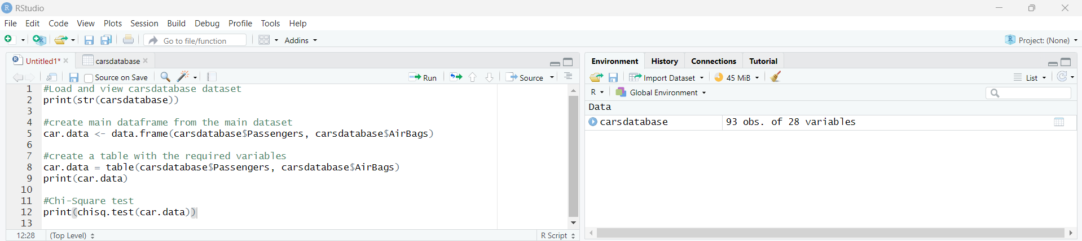
Appendix

Slide 10
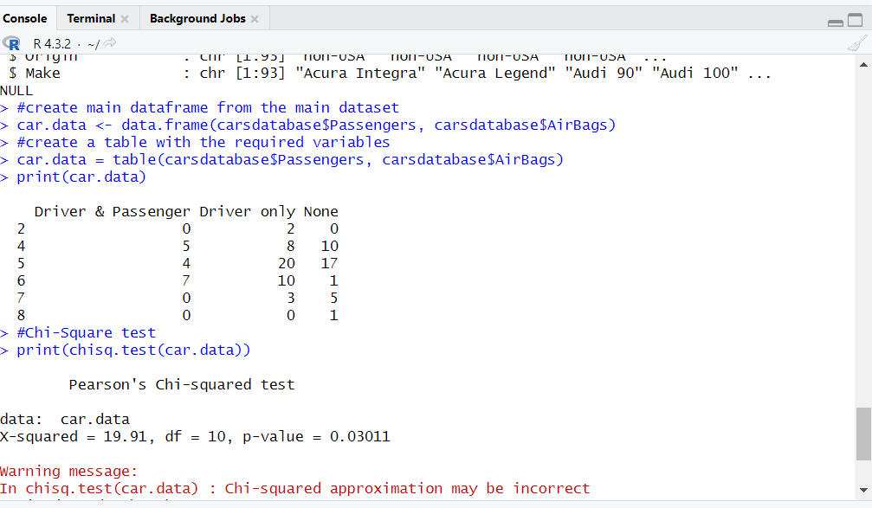
Results

Slide 11
Conclusion
The Chi-squared Analysis has revealed a statistically significant correlation between passenger capacity and vehicle airbag type, resulting in the rejection of the null hypothesis. This correlation emphasizes the significance of giving priority to safety measures, including airbags, in cars intended to accommodate higher passenger capacity.

